Slide 1
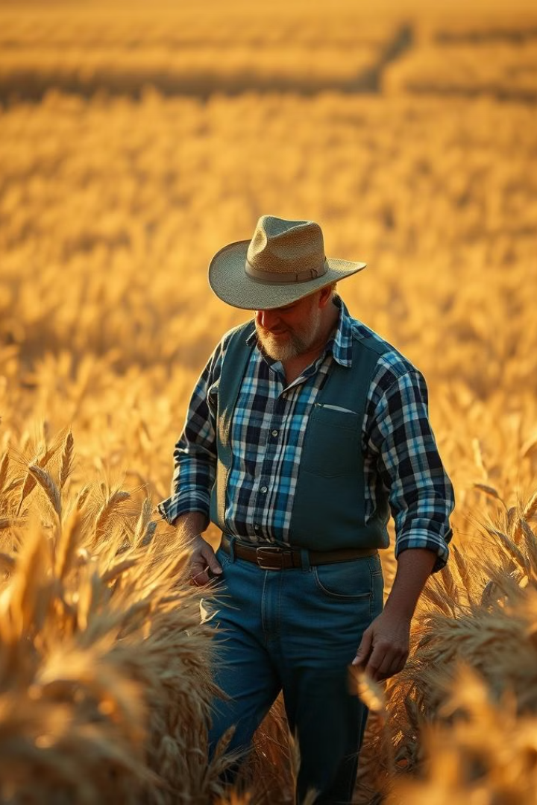
Crop Deal - Enhancing Agriculture with AI
A platform for connecting farmers and buyers with AI-driven crop quality prediction

Slide 2
Overview
To bridge the gap between farmers and buyers by providing a transparent and efficient trading platform.
To enhance the agricultural supply chain with AI-powered technology.
A farmer-buyer connecting platform.
AI-based crop quality prediction using Convolutional Neural Networks (CNNs).
Empowers farmers with insights into their crop quality.
Helps buyers make informed purchasing decisions.
Promotes fair trade practices in agriculture.

Slide 3
Importance of the Project
Challenges Faced by Farmers and Buyers in Traditional Markets:
Lack of Transparency: Farmers often face challenges in determining fair crop prices due to middlemen and limited market access.
Quality Uncertainty: Buyers struggle to assess crop quality without standardized systems, leading to disputes or mistrust.
Inefficient Communication: Limited or indirect communication between farmers and buyers slows down transactions and creates misunderstandings

Slide 4
Importance of the Project
How This Platform Solves Issues with Fair Pricing and Quality Assurance
AI-Powered Quality Prediction: The platform uses CNNs to provide objective crop quality assessments, reducing biases in price negotiations.
Price Standardization: Transparent and data-driven pricing based on quality ensures fairness for both farmers and buyers.
Real-Time Updates: The system offers instant predictions and crop availability updates, streamlining the decision-making process

Slide 5
Importance of the Project
Promotes Direct Farmer-to-Buyer Connection
Seamless Communication: Farmers and buyers can interact directly through the platform, eliminating the need for intermediaries.
Trust Building: Transparency in quality and pricing fosters trust and long-term relationships between farmers and buyers.
Localized Trading: Encourages local markets by connecting nearby farmers and buyers, reducing logistical challenges.

Slide 6
Project Scope
1. Connecting farmers and buyers seamlessly
2. Enabling crop quality prediction with AI
3. Supporting fair trade and transparency in agriculture

Slide 7
Features of the Website
1.User Registration and Authentication
2. Farmer login to upload crop photos and view quality predictions
3. Buyer login to check crop quality ratings and make purchases

Slide 8
Importance of Quality Prediction
- Buyers ensure value for money
- Farmers get insights into crop quality
- Builds trust in the agricultural market
Technologies Used
- Backend:
- Frontend: HTML, CSS, JS , React , Flask
- Database: MySQL/SQLite
- AI Model: TensorFlow/PyTorch

Slide 9
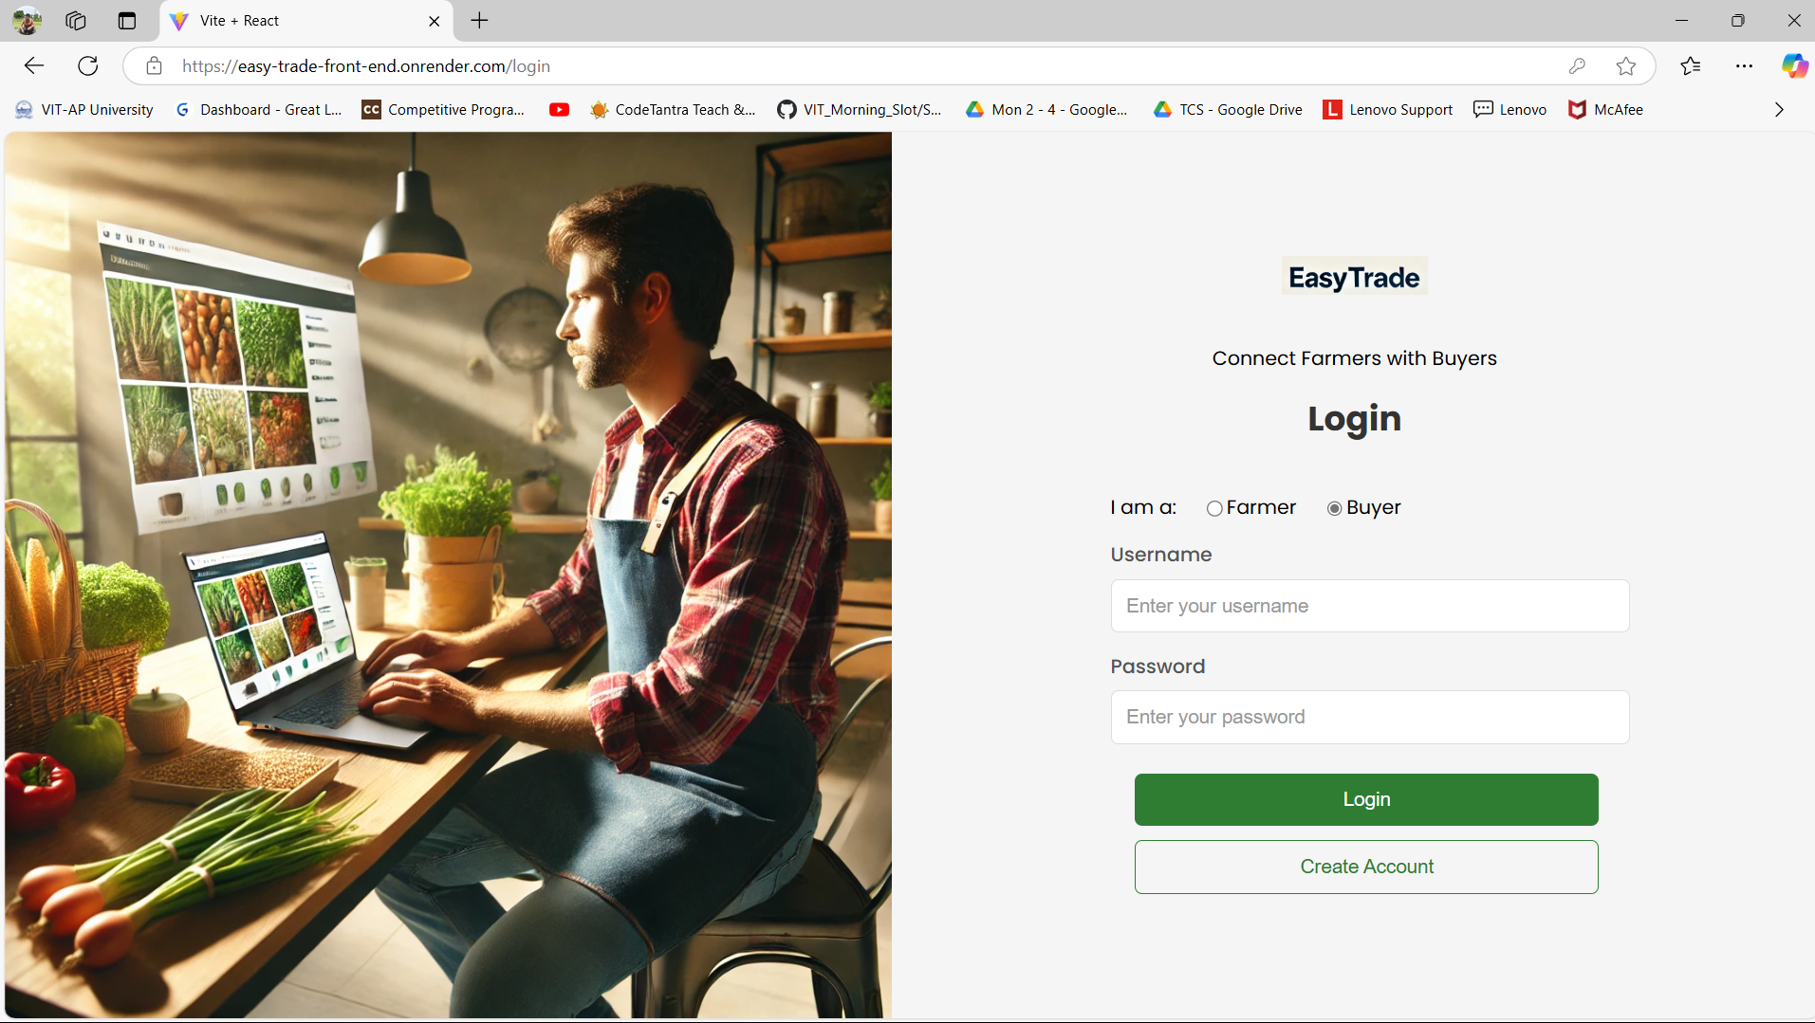
Login Page

Slide 10
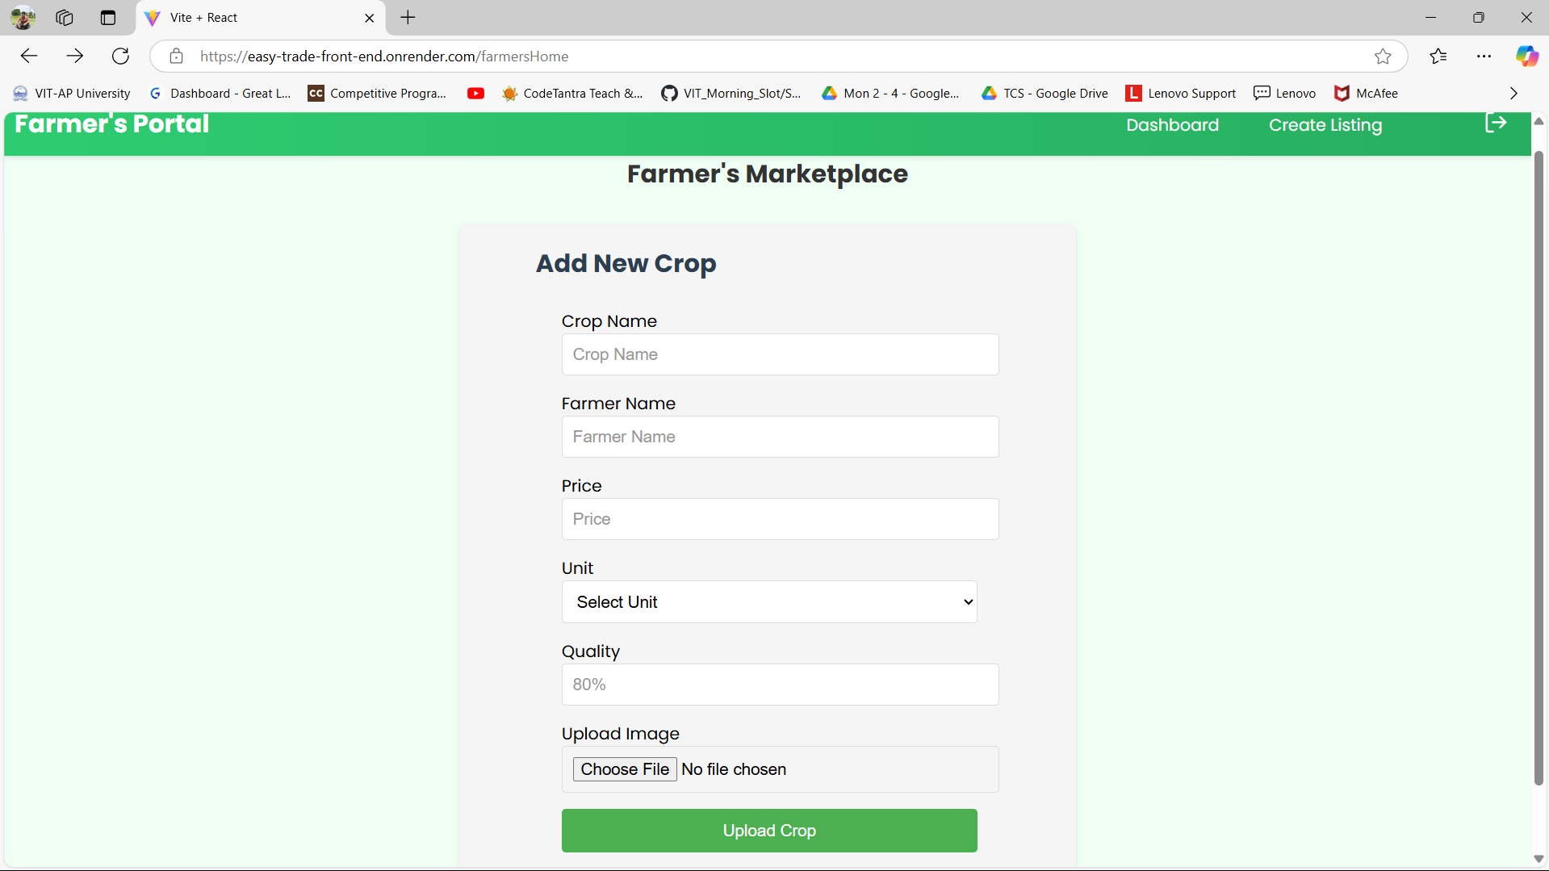
Farmer’s Page

Slide 11
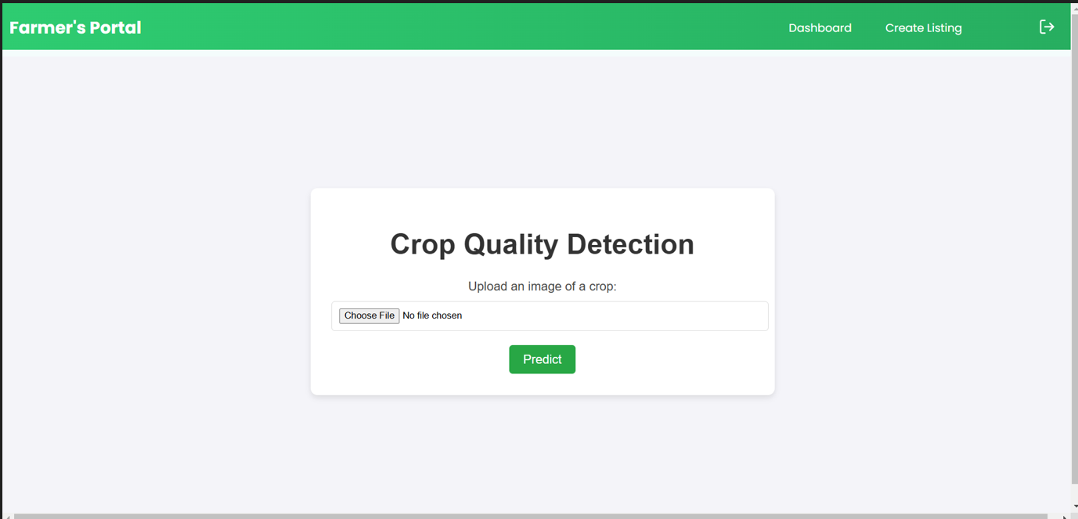
Predicting the quality of the crop

Slide 12
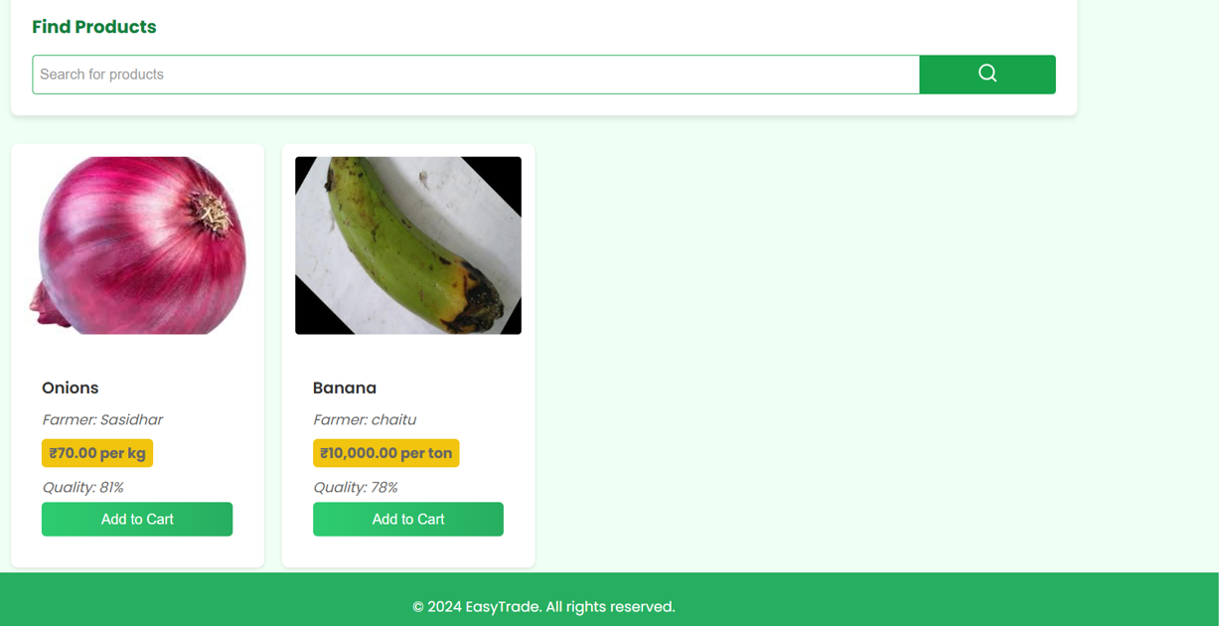
Products Available

Slide 13
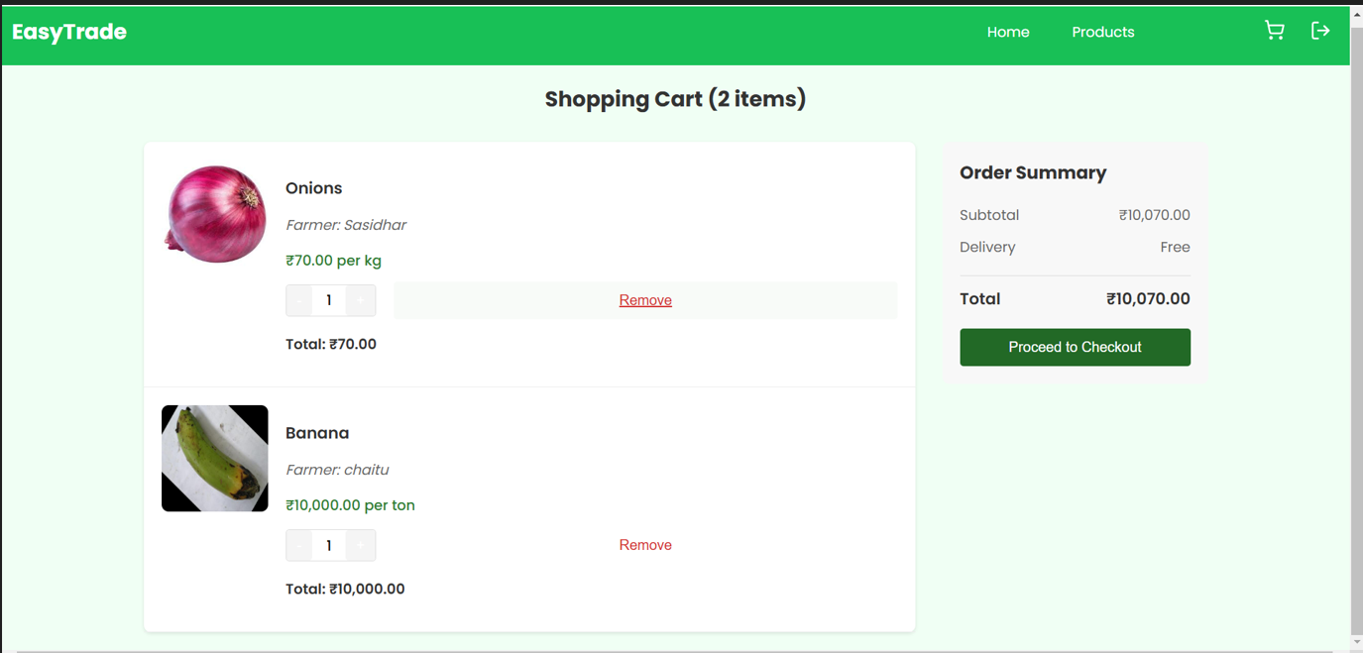
Purchasing and Checkout

Slide 14




Data Acquisition and Preprocessing
Image Collection
Capture images of crops using drones, field cameras, or smartphones, ensuring high resolution and quality.
Data Labeling
Manually annotate images with relevant information, such as crop type, yield estimates.
Data Augmentation
Generate synthetic images by applying transformations to existing ones, increasing training data diversity.

Slide 15
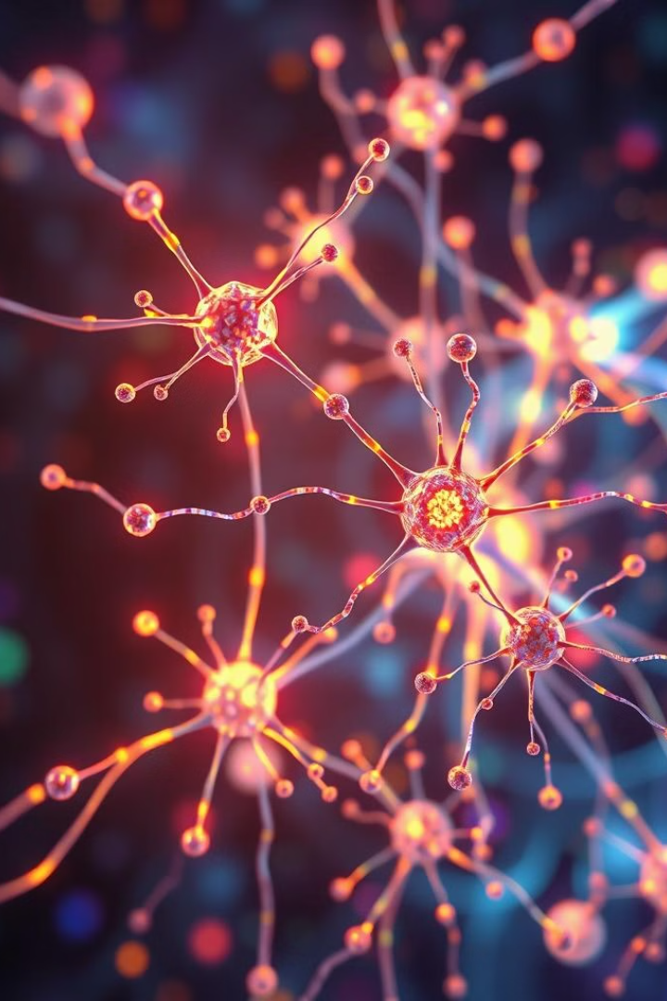
Prediction using Convolutional Neural Networks (CNNs)
1
Convolutional Layers
Extract features from images using filters that scan and detect patterns.
2
Pooling Layers
Reduce the spatial dimensions of feature maps, making the model more efficient.
3
Fully Connected Layers
Process the extracted features and make predictions based on learned relationships.

Slide 16
CNN Model Architecture
Global
Average
pooling
Dense
256
Dense
128
Conv2d(16)
maxpooling2d
Conv2d(32)
Max pooling2d
Conv2d(64)
maxpooling2d
Conv2d(128)
maxpooling2d
Feature Extraction
Output
Input Image
Activation-ReLu
Output: Quality-
Crop-

Slide 17
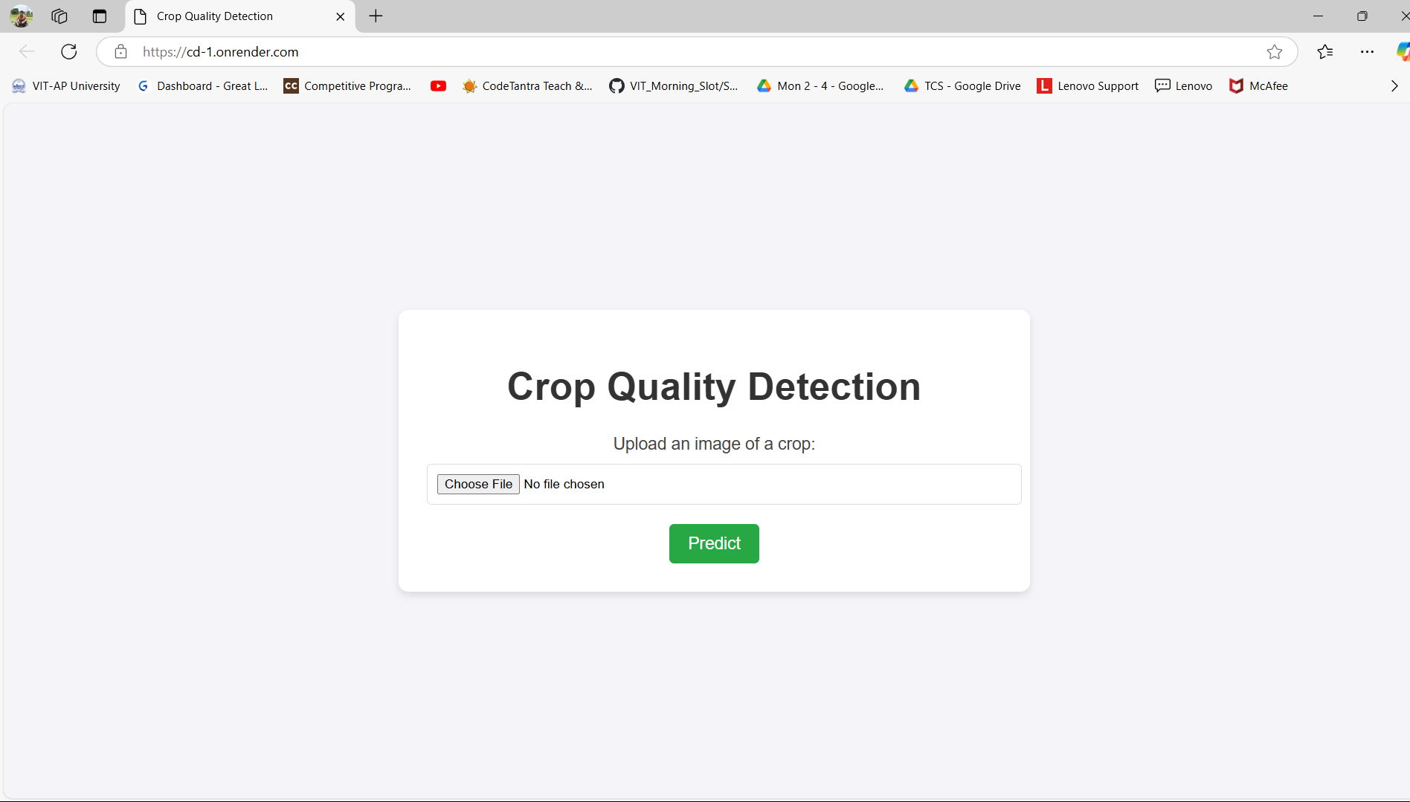
Working of the Model

Slide 18
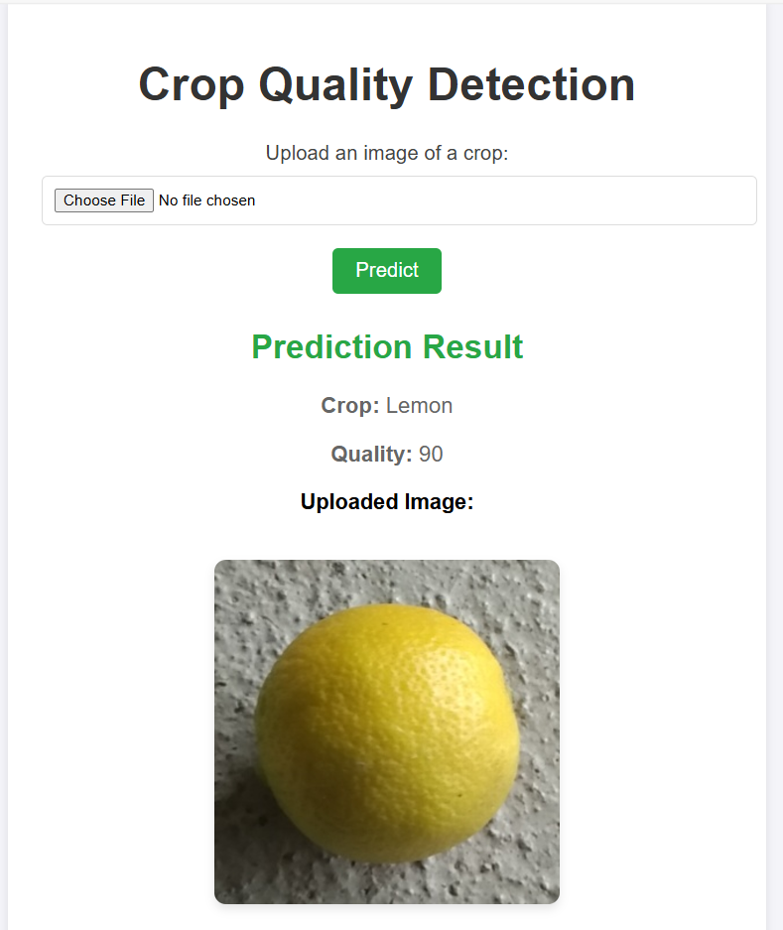
Predictions of the Model

Slide 19
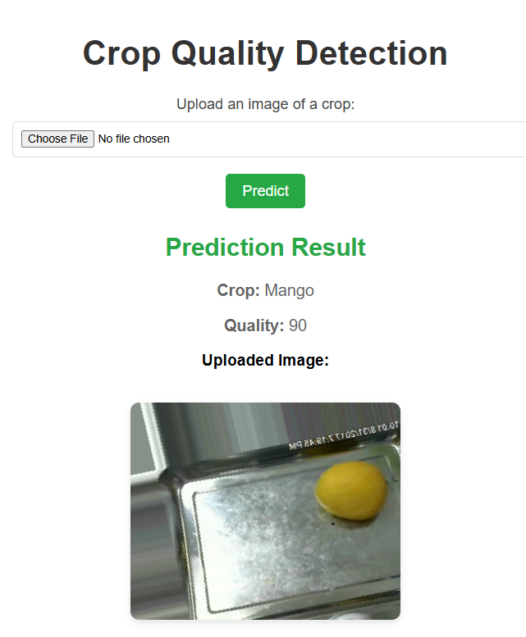
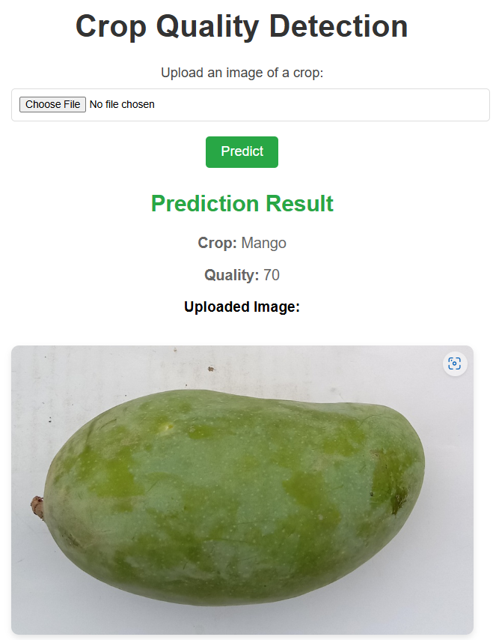
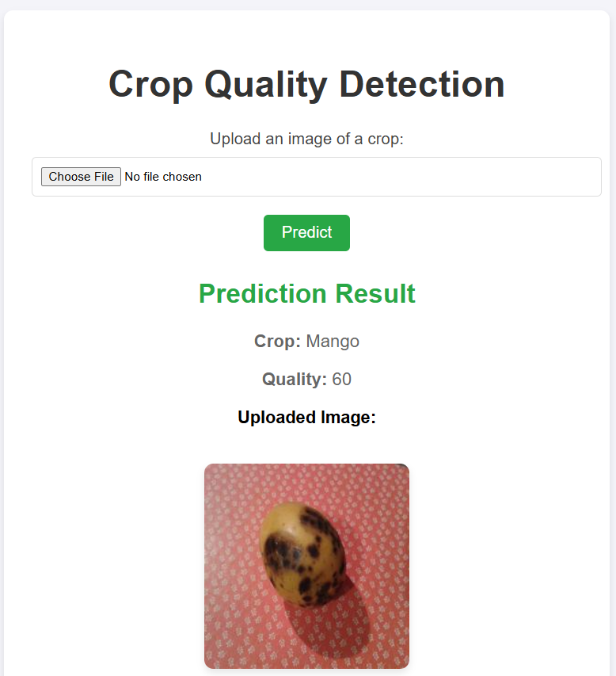
Outcomes of Model
Class1:
Quality -95
Class2:
Quality -70
Class3:
Quality -60

Slide 20




Evaluation Metrics and Performance Analysis
Accuracy
Proportion of correctly classified samples->93.8%
Precision
Ability to correctly identify positive samples.(0.89)
Recall
Ability to correctly identify all positive samples.(0.88)
F1-Score
Harmonic mean of precision and recall.(0.89)

Slide 21
THANK YOU

